Slide 1



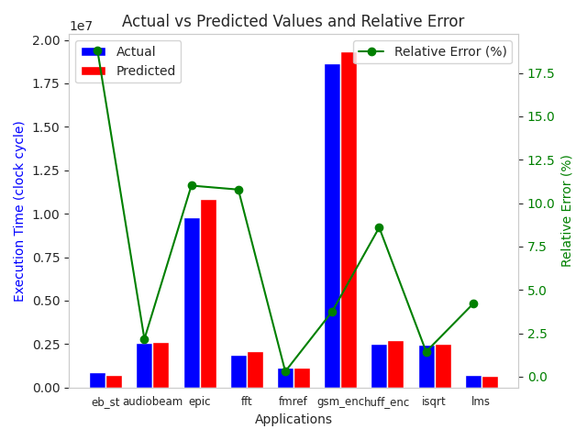




QEMU-based CVA6 Framework for Efficient Functional Validation and Performance Evaluation
Igor MACANOVIC, Fatma JEBALI, Caaliph ANDRIAMISAINA
CEA-List
Context
Approach
Instruction Set Simulators (ISS) abstract away micro-architectural details for fast functional validation, thus not suitable for execution time estimation.
Cycle-accurate simulators provide accurate performance evaluation, but at the cost of low simulation speed.
Need for simulation frameworks for efficient functional validation and performance evaluation.
Leverage machine learning techniques to generate performance models, using features extracted from cycle-accurate simulations.
Extend QEMU with the generated performance models for fast and accurate execution time estimation.
Validated on CVA6, a RISC-V ISA implementation.
Methodology & Framework
Enhance RTL simulation efficiency with Verilator for training and test datasets generation.
Monitor executed instructions with counters, which serve as input features for the machine learning model.
Train and validate the performance model.
Leverage TCG (Tiny Code Generator) plugins for efficient QEMU instrumentation.
Collect instruction counters’ values at the end of simulation.
Feed the collected counters to the performance model for execution time estimation.
Results
Conclusion
Showed the feasibility and effectiveness of extending QEMU with ML-based models for fast performance estimation.
Validated the approach on the CVA6 RISC-V ISA implementation.
Future work will focus on enabling architectural exploration capabilities.
The overhead introduced by the performance model decreases as the simulation time increases.
For unseen applications, the average and max errors are less than 7% and 19% respectively.
TRISTAN website
QR Code
TRISTAN Project has received funding from the Chips Joint Undertaking (Chips-JU) under the grant agreement nr. 101095947. Chips-JU receives support from the European Union’s Horizon Europe’s research and innovation programme and Austria, Belgium, Bulgaria, Croatia, Cyprus, Czechia, Germany, Denmark, Estonia, Greece, Spain, Finland, France, Hungary, Ireland, Israel, Iceland, Italy, Lithuania, Luxembourg, Latvia, Malta, Netherlands, Norway, Poland, Portugal, Romania, Sweden, Slovenia, Slovakia and Turkey.
Notes:
Demonstrated feasibility and effectiveness of extending QEMU with ML-based models for efficient performance estimation.

